Slide 1



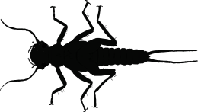
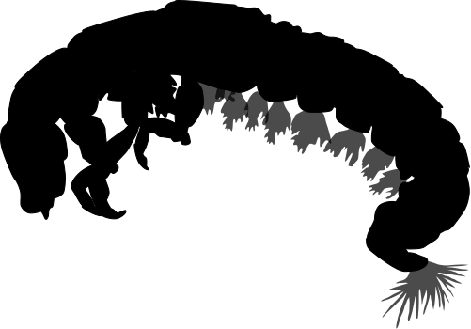






Body size distributions in stream communities: A new biomonitoring tool
Dr. Justin Pomeranz
jfpomeranz@gmail.com
N
N
@NotAPomegranite
github.com/Jpomz
jfpomeranz.wixsite.com/ecologist
M
M

Slide 2
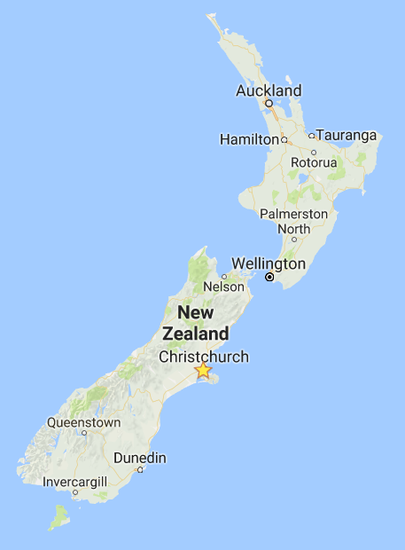
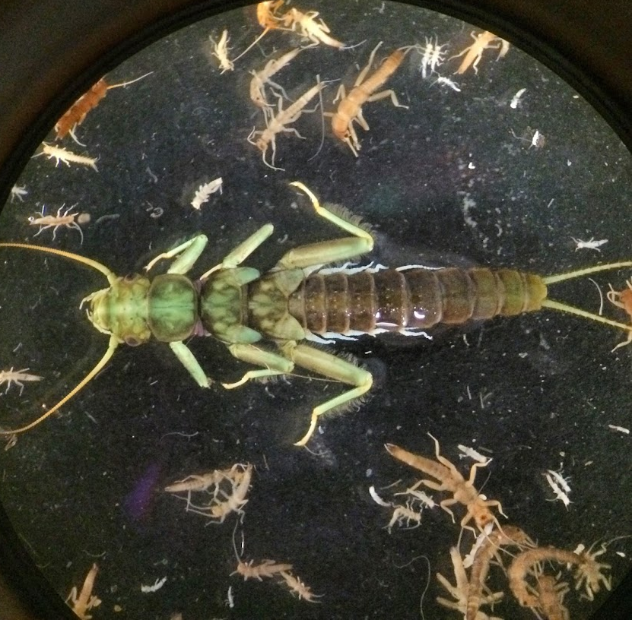
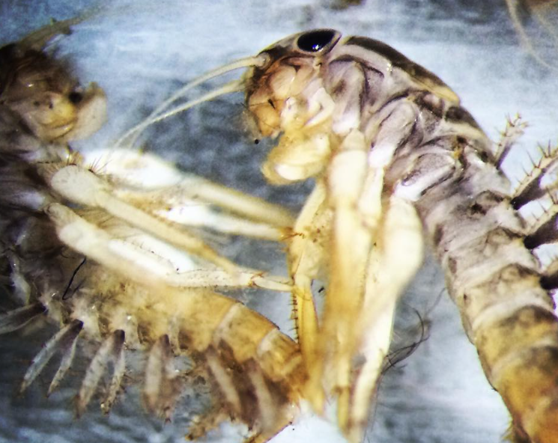
About me…
Aquatic entomologist (BUGS!) & ecologist
Study how human activities affect stream communities
Biomonitoring
Assessing impacts of Acid Mine Drainage in New Zealand

Slide 3
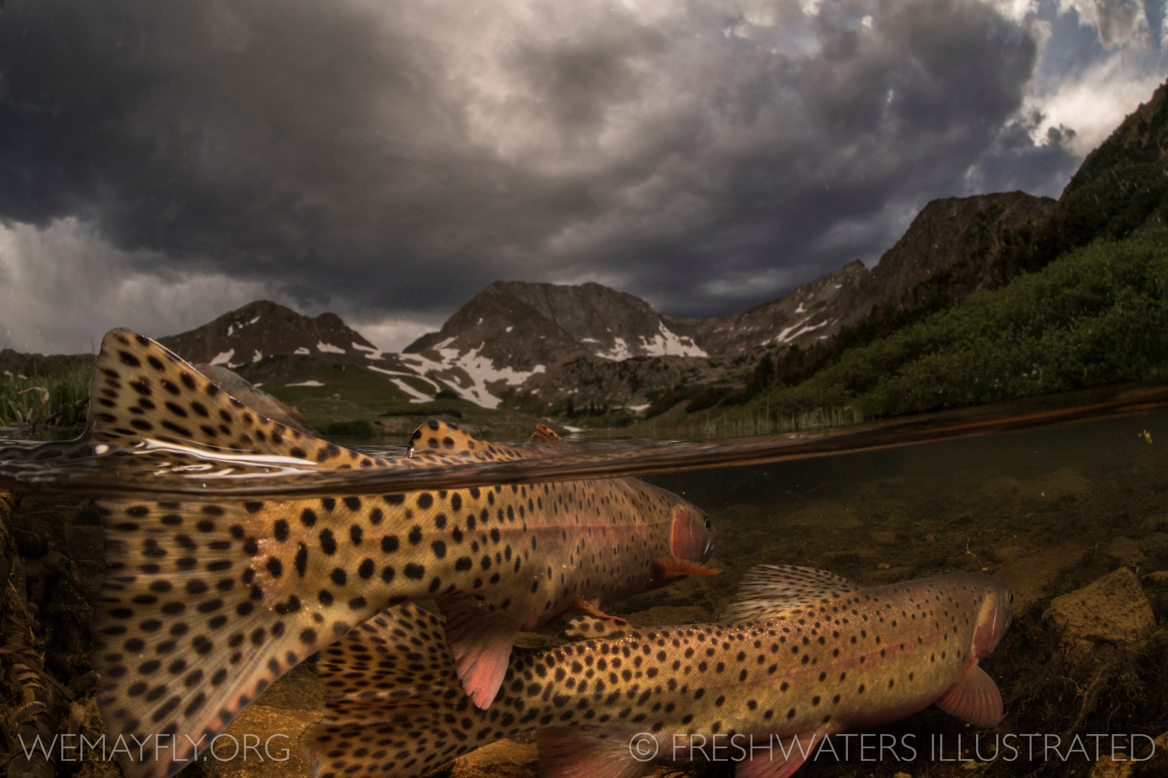
Overview – where are we going?
Biomonitoring
The importance of body size
Body size distributions in communities
Deviations in distribution tell us about ecosystem health
Can this be used to monitor stream communities?
How will this research continue at CMU?

Slide 4
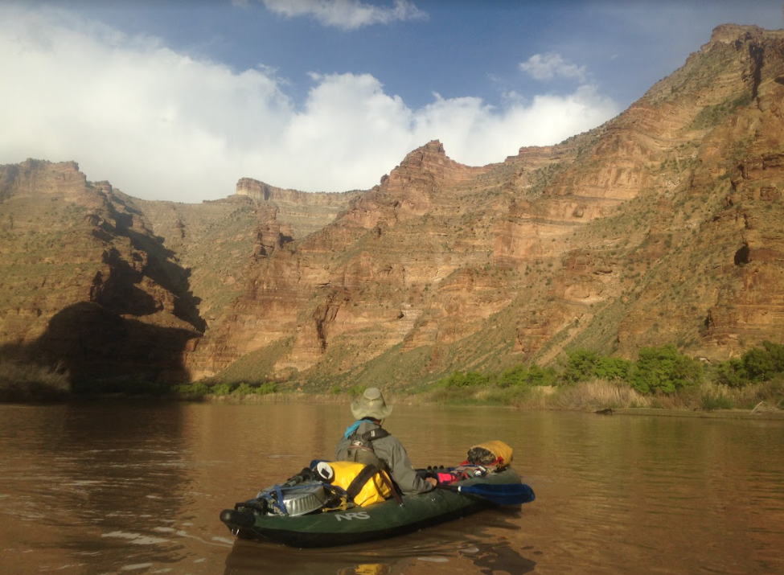
Importance of freshwater cannot be overstated…
Limited natural resource
Vital for life, ecosystems, and
civilization
Human uses
Municipal water
Agriculture
Industrial
Recreation

Slide 5
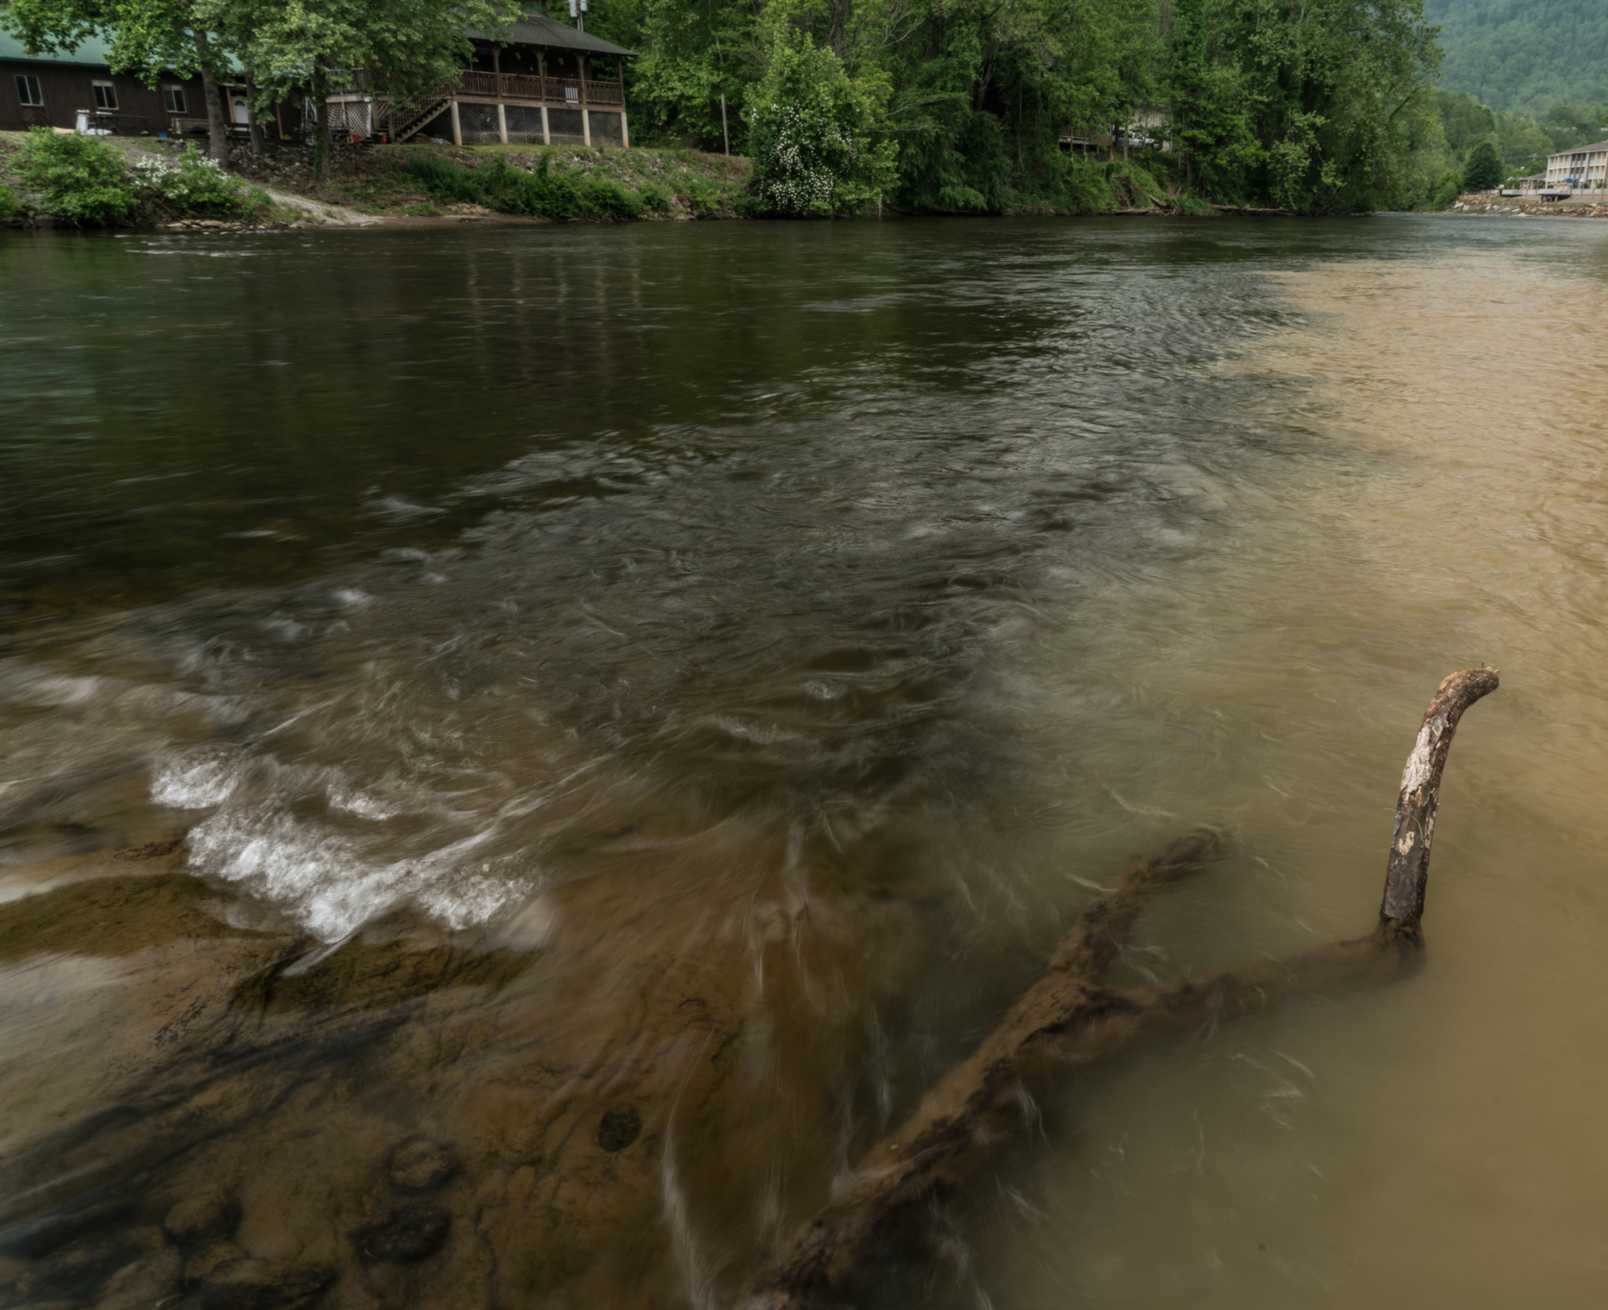
There are many threats to freshwater quality…

Slide 6
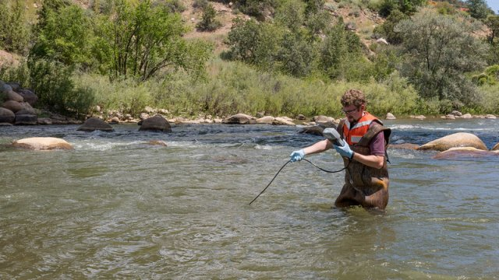
Assessing water quality…
Chemical characteristics
pH
Dissolved ions
Metal concentrations
O₂
Physical characteristics
Temperature
Sediment
Water clarity
Width, depth
Bank stability
Credit: Eric Vance/EPA https://www.epa.gov/goldkingmine

Slide 7
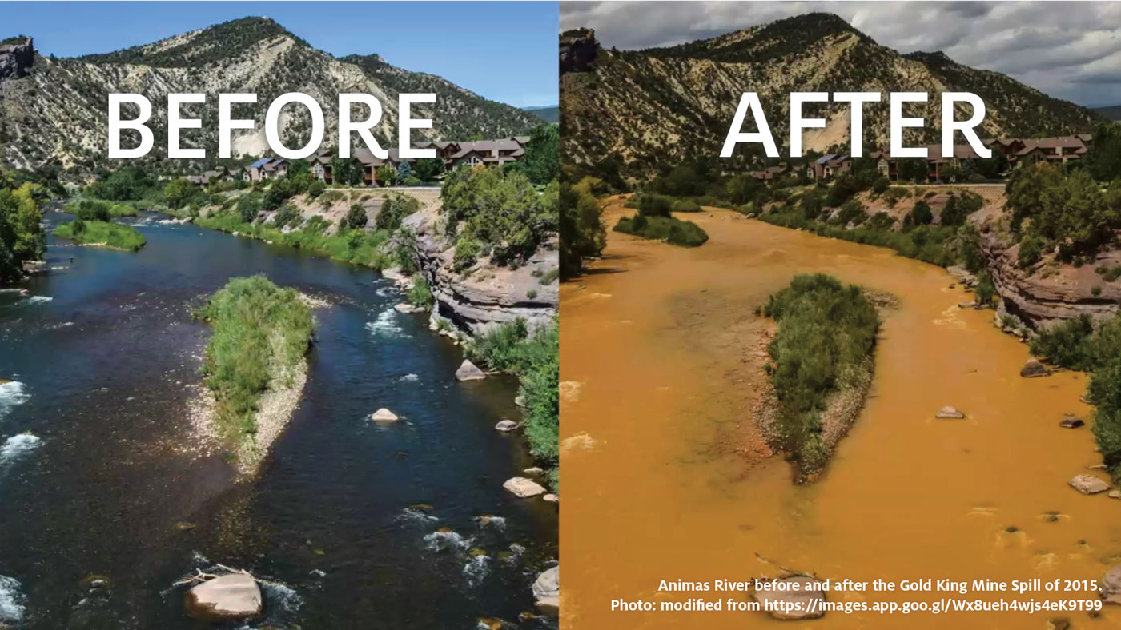
Physical and chemical measurements are only a snapshot in time…
Animas River near Durango, CO
August 4, 2015
August 4, 2015

Slide 8
Physical and chemical measurements are only a snapshot in time…
Animas River near Durango, CO
August 4, 2015
August 5, 2015

Slide 9
Biomonitoring…
“The use of living organisms to assess environmental conditions.”
Integrate conditions through time
Physical/chemical measurements are a picture
Biomonitoring is a movie
Sensitive vs. tolerant species
Extensive background research
Lab and field studies
Pollution

Slide 10
Shortfalls of traditional biomonitoring techniques…
What species should you expect to find?
This is not a trivial task!
Biogeographical constraints
What works in CO may not work in Alabama
Let alone, New Zealand, SE Asia, Africa…
Assuming you do have the proper background knowledge…
Relies on correct ID of all individuals
Difficult with small, immature, or damaged specimens
Body size metrics may offer an alternative…

Slide 11
Outline
Biomonitoring
The importance of body size
Body size distributions in communities
Deviations in distribution tell us about ecosystem health
Can this be used to monitor stream communities?
How will this research continue at CMU?

Slide 12

Why is body size so important?

Slide 13
Body size as a “master” variable…
Correlated with:
Metabolism
Life History
Predator-prey interactions
Trophic Position
Movement
Brown et al. 2004. Ecology
Reide et al. 2010. Ecology
Brose et al. 2017 BioRev
Eklöf et al. 2013 EcoLetters

Slide 14
Animal icons…
Represent Species
Scaled to average body size
Fish
Stonefly
Caddisfly
Mayfly
Grayed out = Missing
Midge

Slide 15
Body size as a “master” variable…
Correlated with:
Metabolism
Life History
Predator-prey interactions
Trophic Position
Movement
Brown et al. 2004. Ecology
Reide et al. 2010. Ecology
Brose et al. 2017 BioRev
Eklöf et al. 2013 EcoLetters

Slide 16
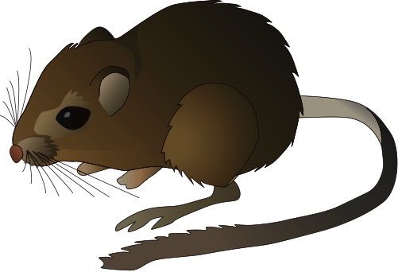
Pocket Mouse interlude…
Small Body size:
Metabolism
Fast
Life History
Short generation
High reproductive potential

Slide 17

African Bush Elephant…
Large Body size:
Metabolism
(relatively) slow
Life History
Long generation
Low reproductive potential
Long gestation
Extended Juvenile phase

Slide 18
African Bush Elephant…
Large Body size:
Metabolism
(relatively) slow
Life History
Long generation
Low reproductive potential
Long gestation
Extended Juvenile phase

Slide 19
Back to the streams…
Metabolism
(relative)
Generation time
Reproductive potential
Slow
Many years
Once per year
“Medium”
1 – 4 years
Once per year
Fast
~1 year
1 – 3 per year
Very fast
< 1 year
Many per year

Slide 20
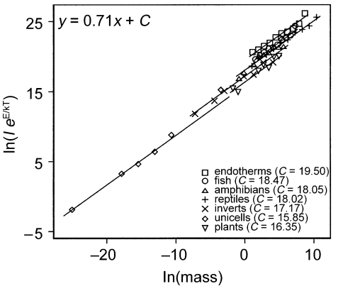
Relative metabolic rate declines with body size…
…Larger individuals require more net energy
From Brown et al. 2004. Ecology

Slide 21
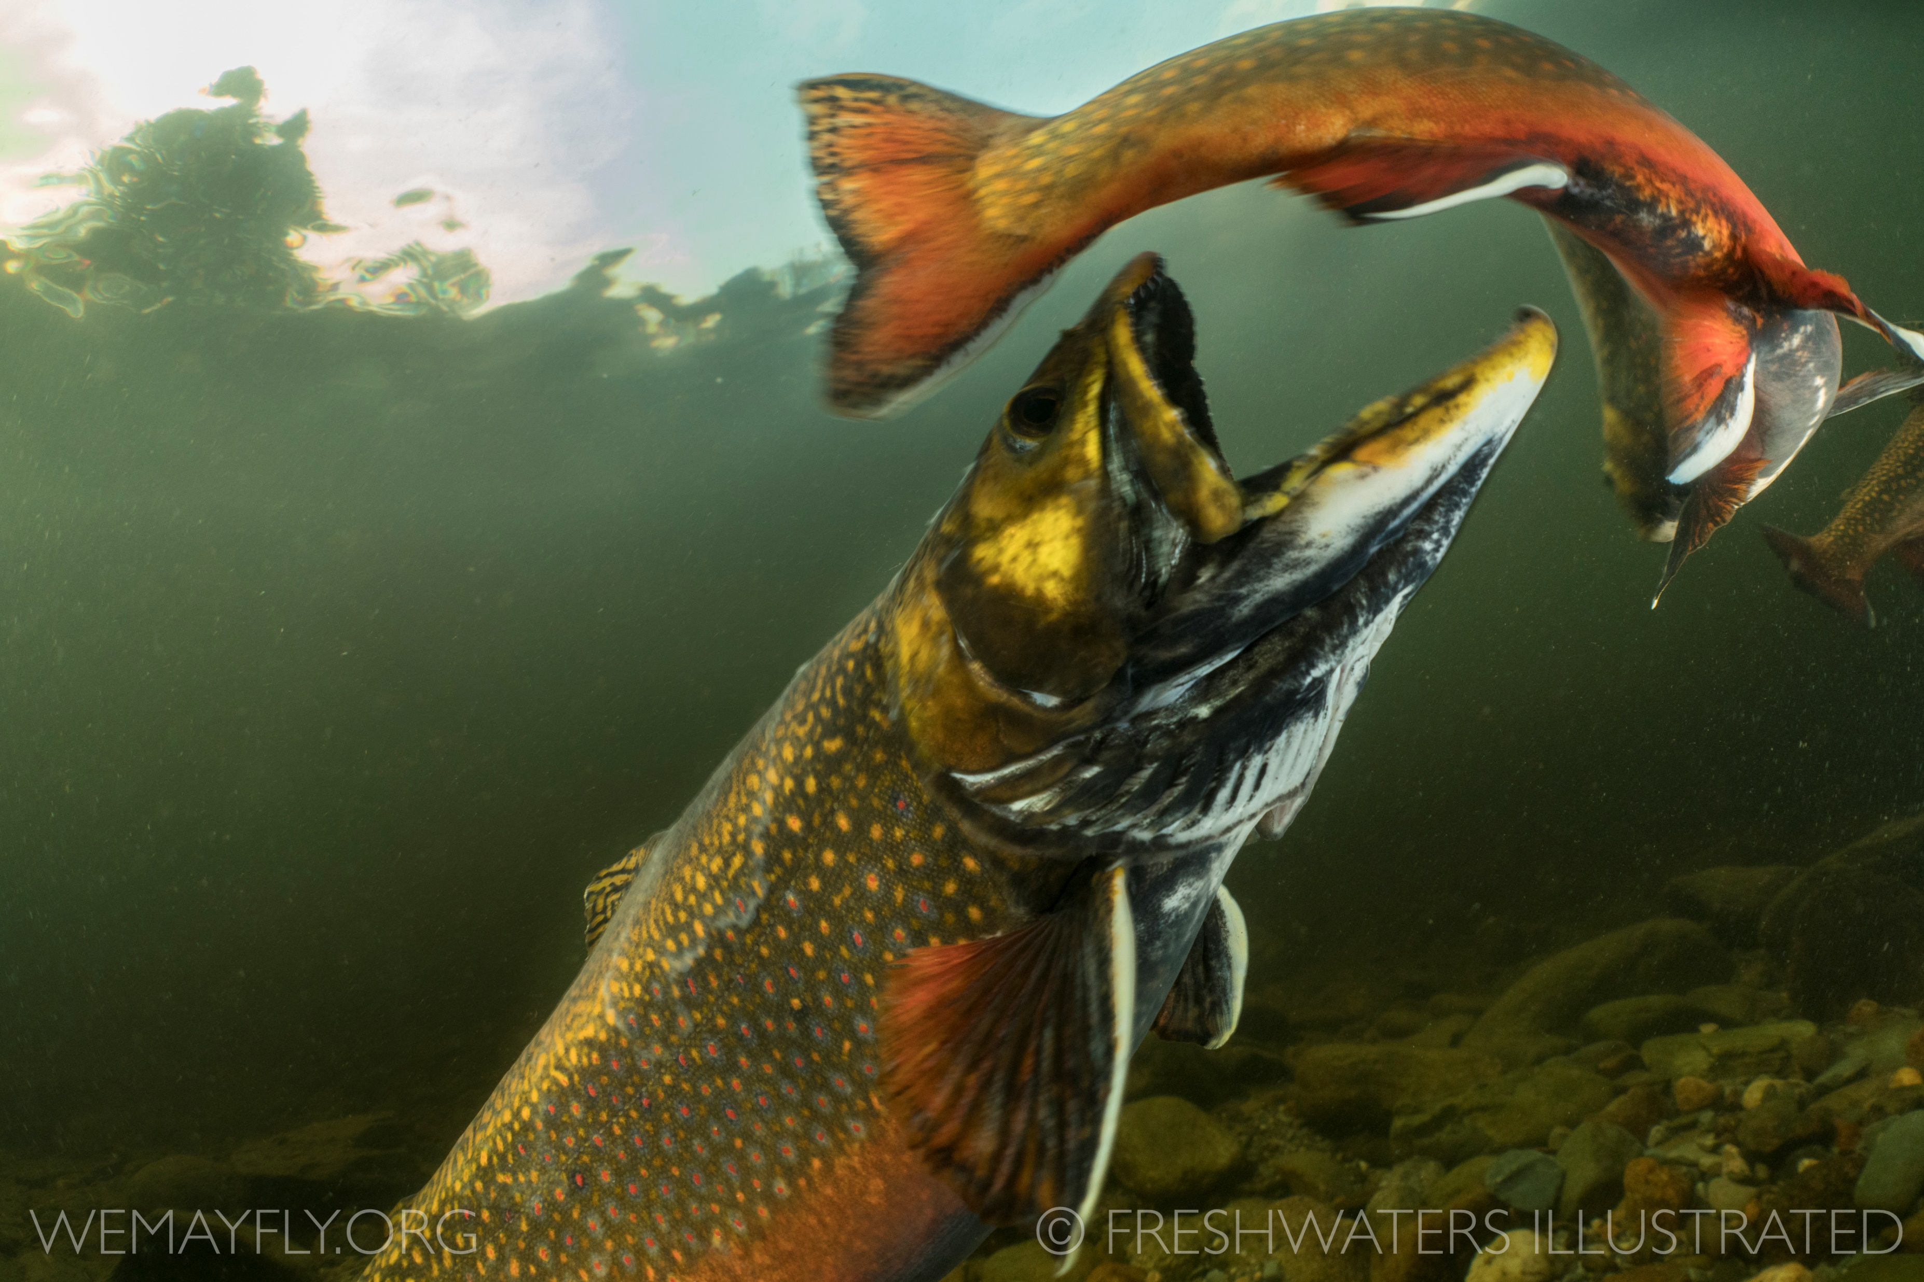
Body size controls predator-prey interactions…

Slide 22
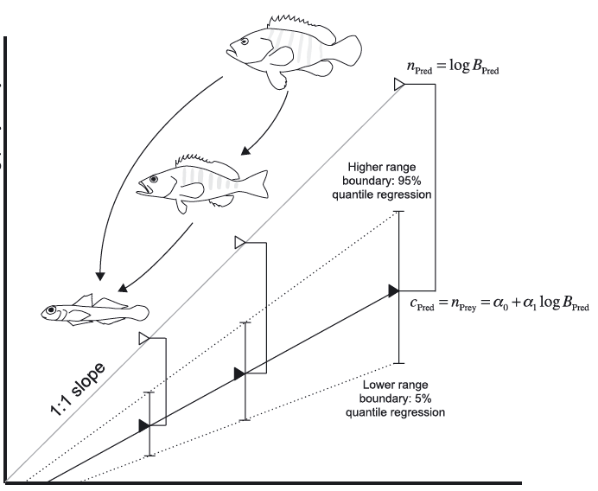
Body size controls predator-prey interactions…
Prey
… with prey being smaller than predators
Predator

Slide 23
Trophic position increases with body size….
Larger individuals are generally higher up the food chain
Apex Predator
Predator
Herbivore

Slide 24
A brief detour…
Icons represent species-averaged size
Individual body size varies within a species
As individuals grow, transition through ontogenetic diet shifts
Herbivore
Predator
Herbivore → Predator

Slide 25
Body size summary…
One measurement gives information on
Biology
Energy use
Life history
Species interactions
Community organization
Ecology
Body size is a “magic ruler”

Slide 26
Outline
Biomonitoring
The importance of body size
Body size distributions in communities
Deviations in distribution tell us about ecosystem health
Can this be used to monitor stream communities?
How will this research continue at CMU?

Slide 27
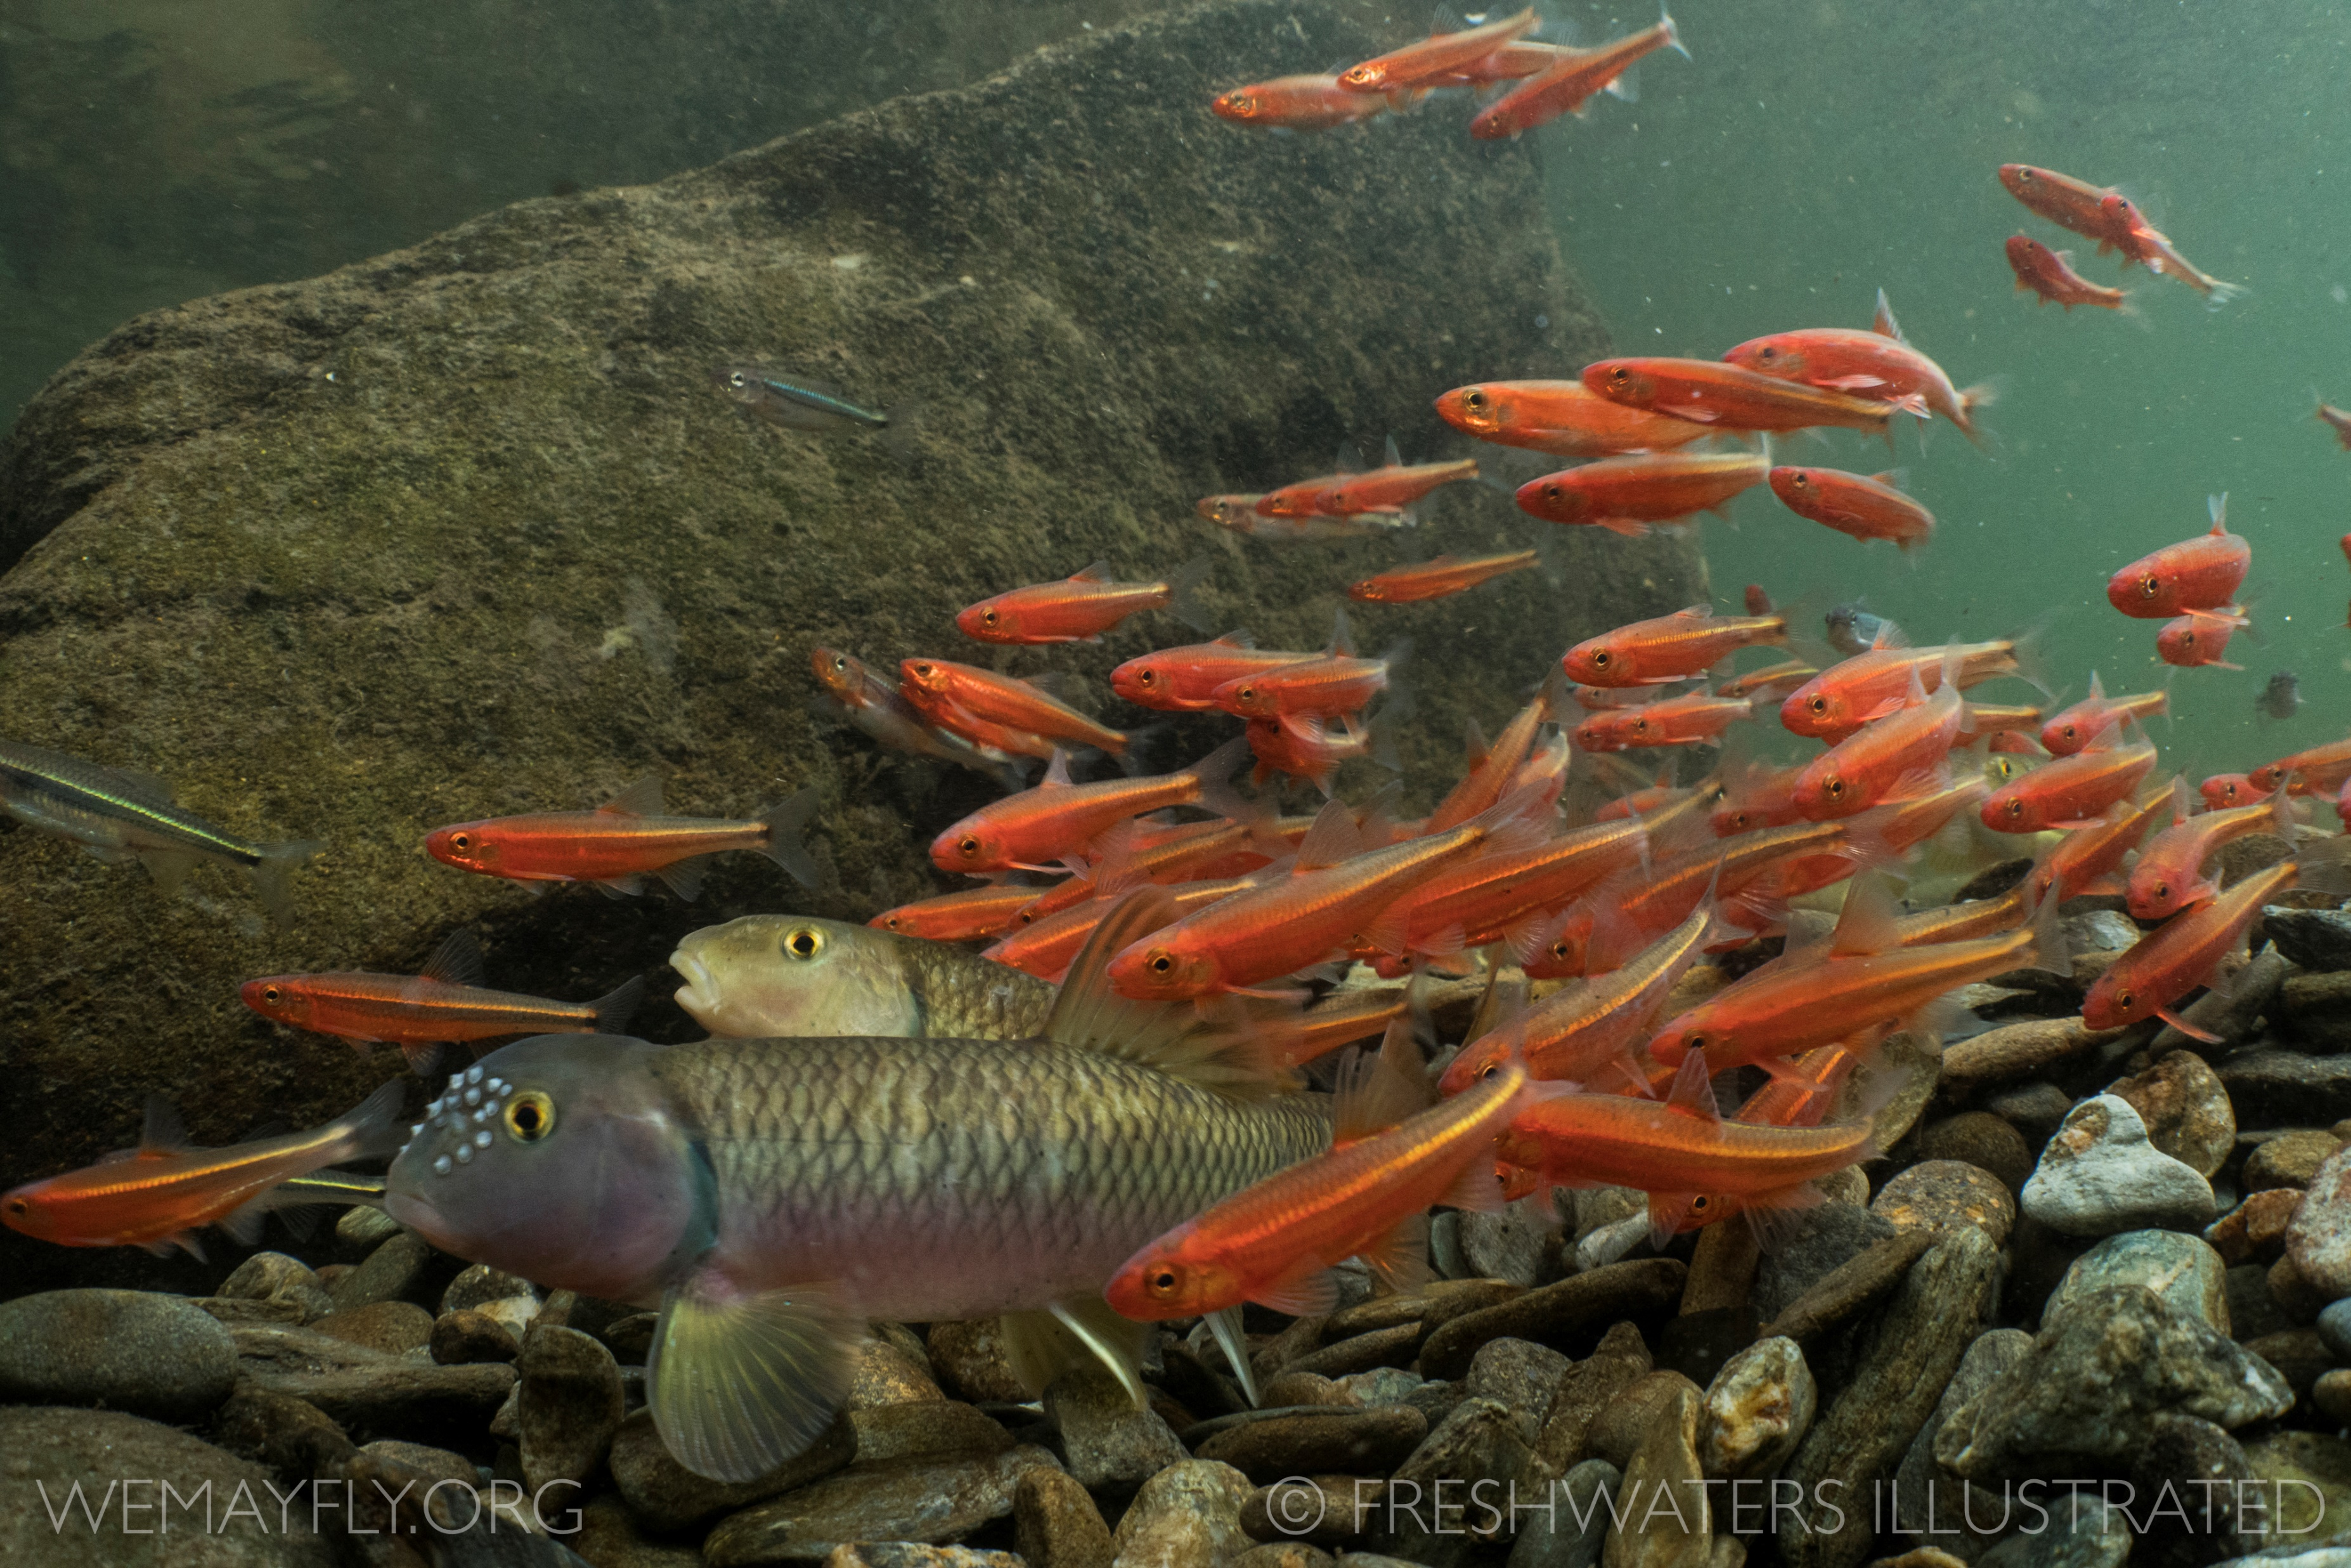
How is body size distributed within communities?

Slide 28
Abundance decreases with body size….

Slide 29
Abundance decreases with body size….
…Communities have many small individuals and a few large ones

Slide 30
Communities organized in a “Pyramid of numbers”…

Slide 31
Communities organized in a “Pyramid of numbers”…
Body Size, M
Abundance, N

Slide 32
Size spectra = mathematical transformations of the Pyramid of Numbers…
M
N
Modified from Trebilco et al. 2013

Slide 33
Size spectra = mathematical transformations of the Pyramid of Numbers…
M
N
N
M
Flip the axes
Modified from Trebilco et al. 2013

Slide 34
Size spectra = mathematical transformations of the Pyramid of Numbers…
Slope = -1.0
M
N
Log₁₀ N
N
M
Log₁₀ M
Log transformation
Linear regression
Flip the axes
Modified from Trebilco et al. 2013

Slide 35
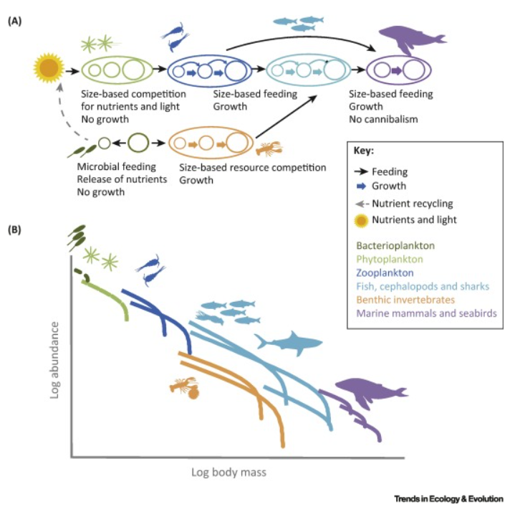
Pattern holds across scales in “natural” communities…
…From bacteria to Blue Whales
Blanchard et al. 2018

Slide 36
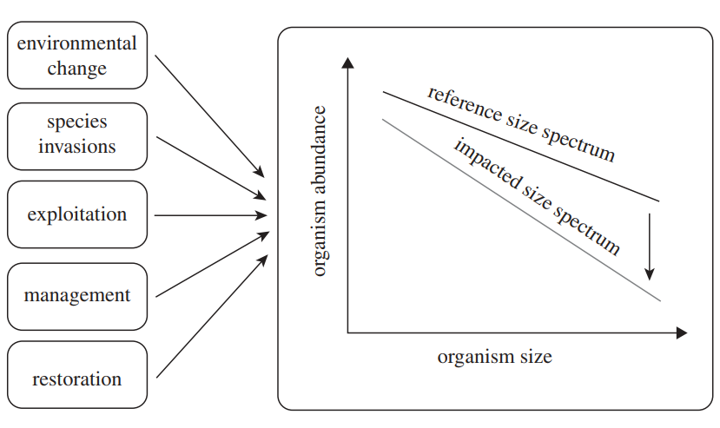
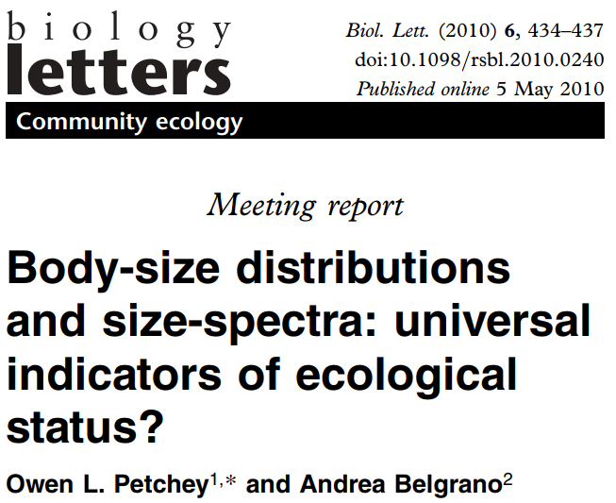
Consistent across reference habitats and climates…
One of the few “rules” in community ecology
Slope = -1.0

Slide 37
Relationship varies in response to disturbances …
Slope = -1.0

Slide 38
Relationship varies in response to disturbances…
Use in biomonitoring?
Slope = -1.0
Slope ≠ -1.0

Slide 39
Outline
Biomonitoring
The importance of body size
Body size distributions in communities
Deviations in distribution tell us about ecosystem health
Can this be used to monitor stream communities?
How will this research continue at CMU?

Slide 40
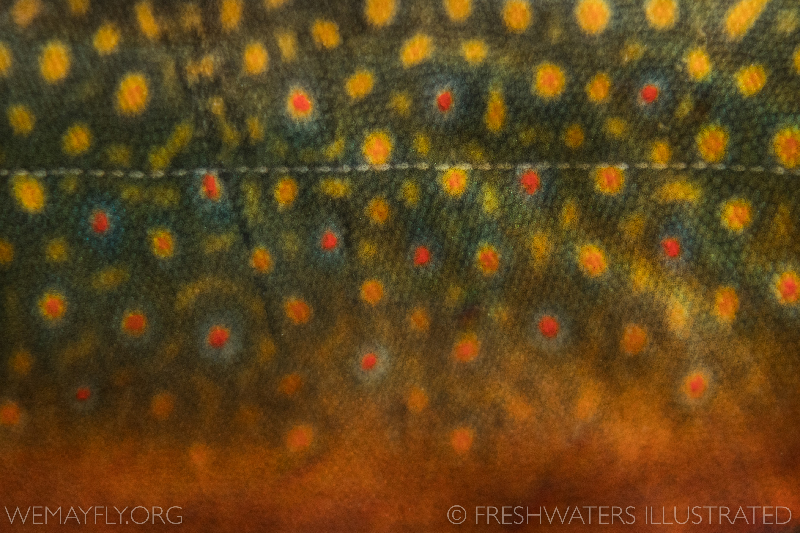
Can size spectra be used as a biomonitoring tool in stream communities?

Slide 41
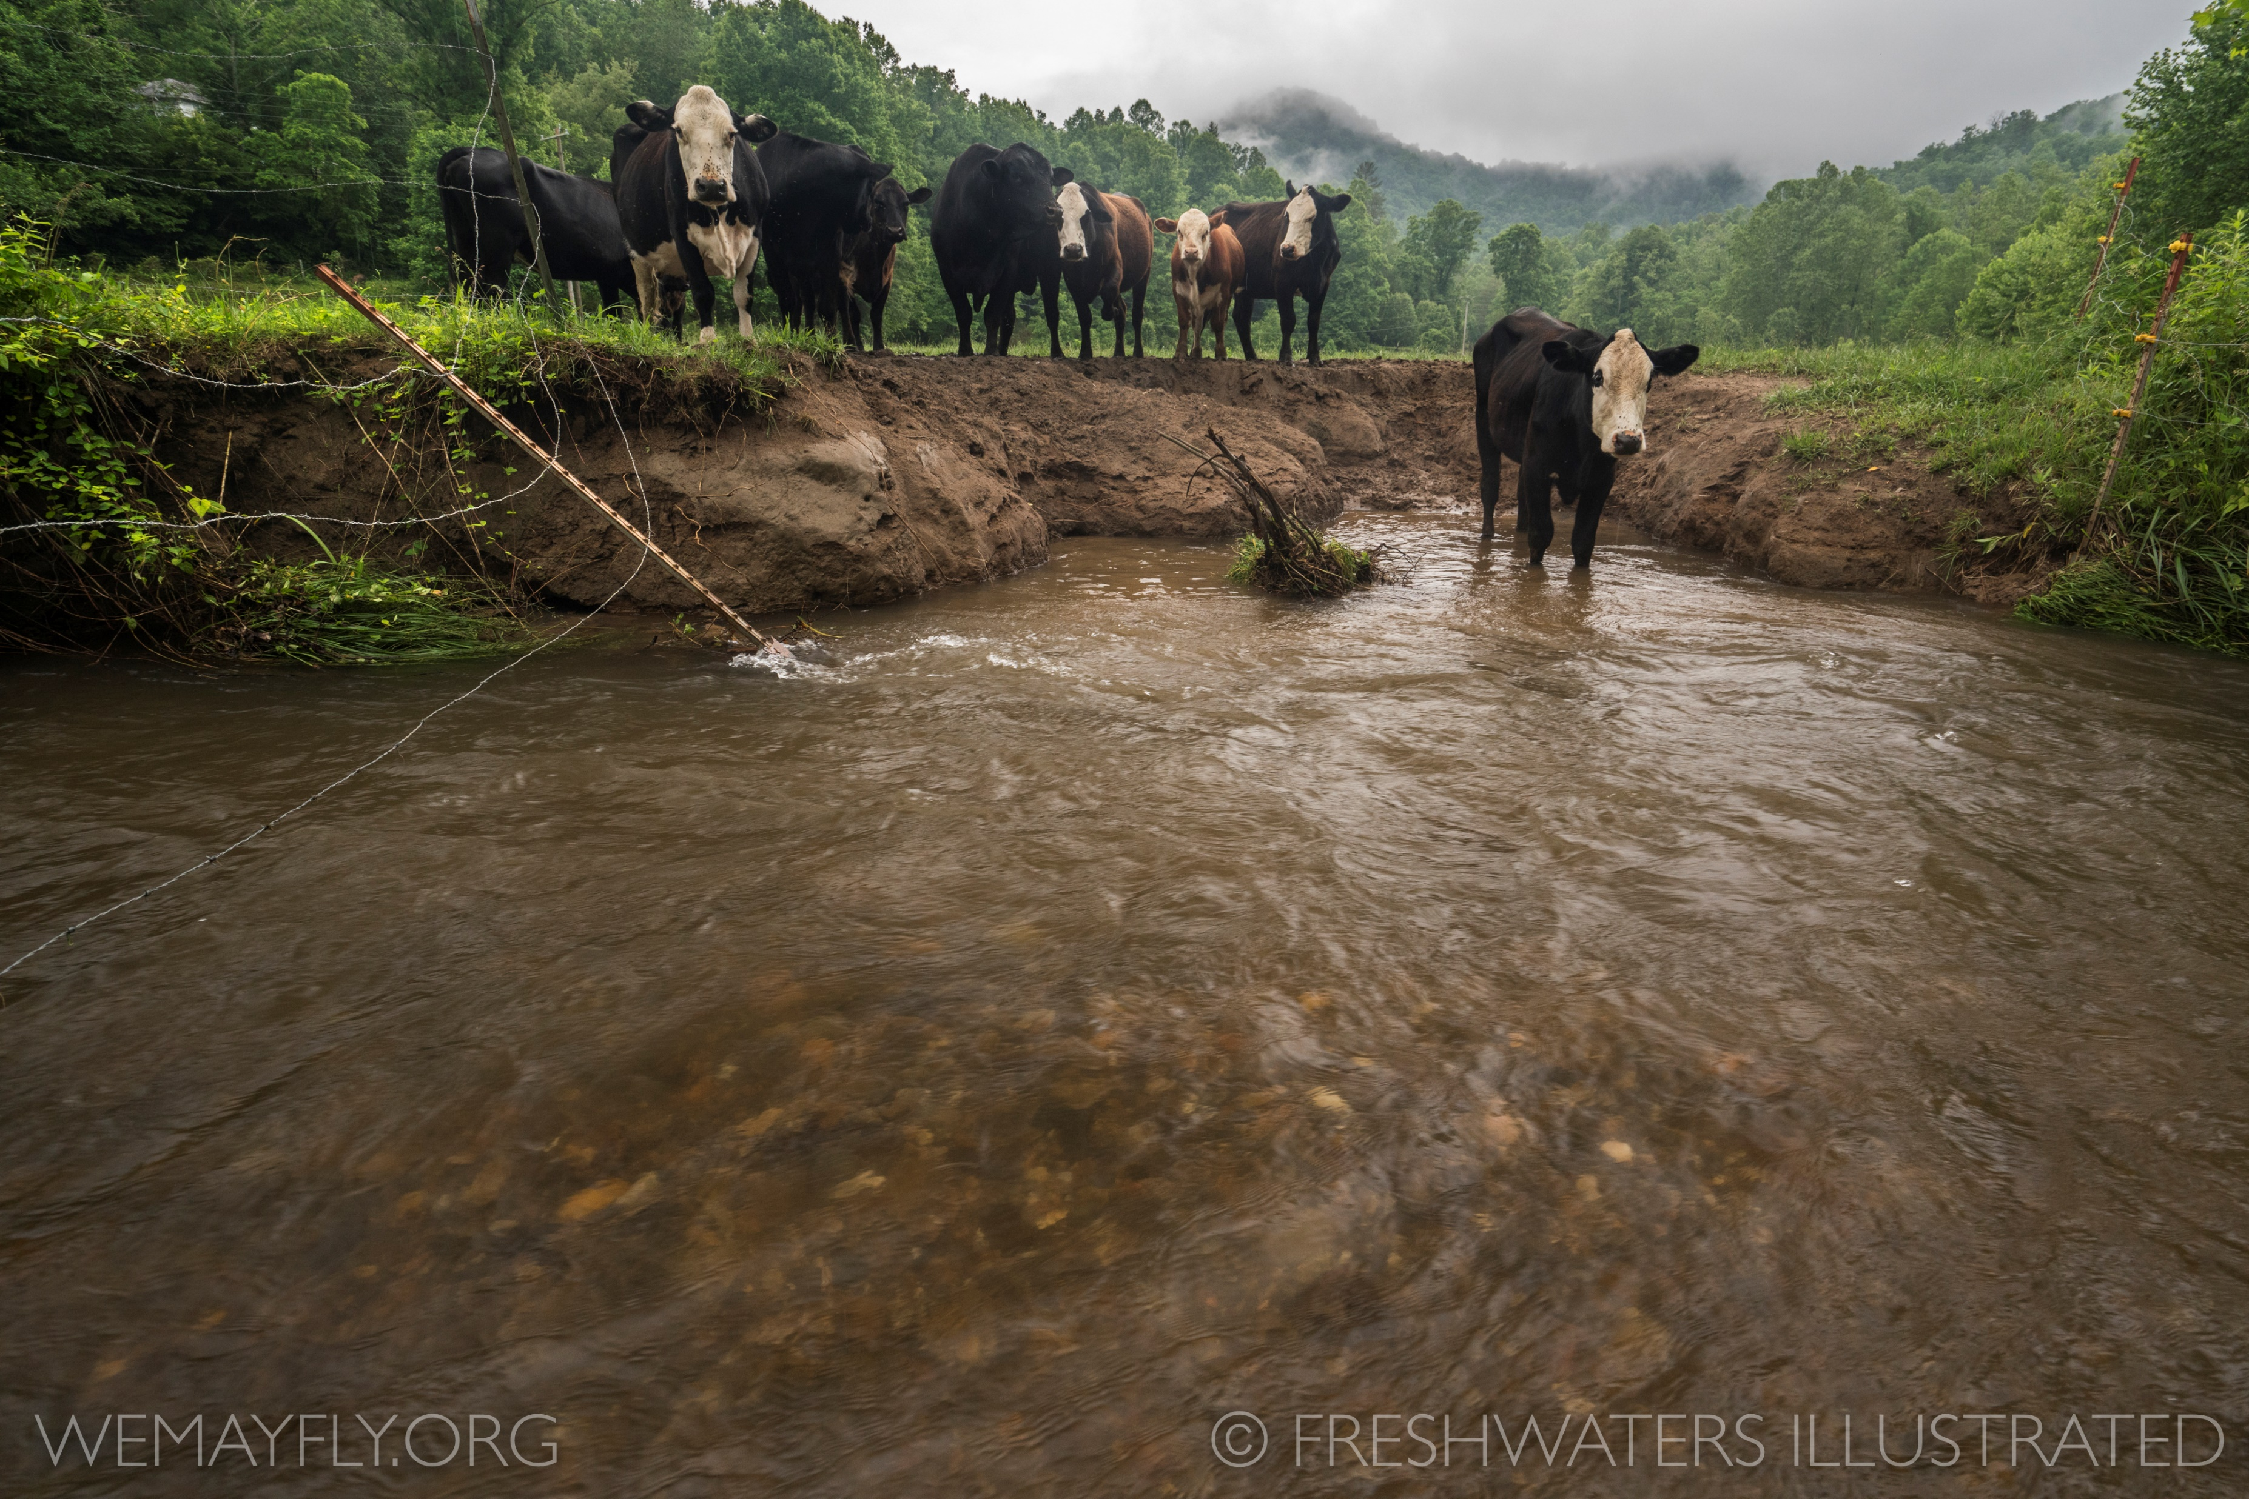
Driving questions
Can size spectra be used as a “universal” indicator?
Do size spectra in unimpacted stream communities in NZ follow observed pattern?
Do size spectra relationships change consistently in response to AMD?

Slide 42
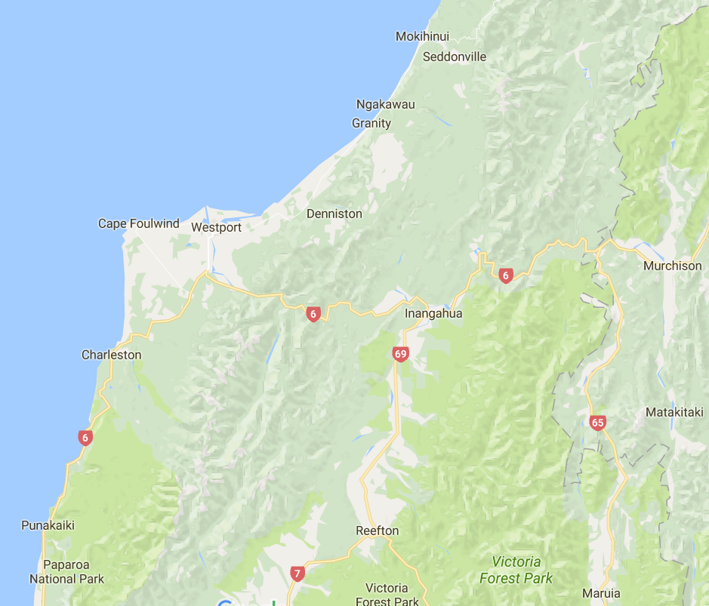
Field survey of streams across a gradient of AMD impacts…
25 Sites | 13 impacted |
12 “reference”
Reference = natural range of pH 4-7
Tomato juice – neutral
pH | [metal] | Invertebrates
Notes:
Talk about sample size here
Number of INDIVIDUALS
Ethanol

Slide 43
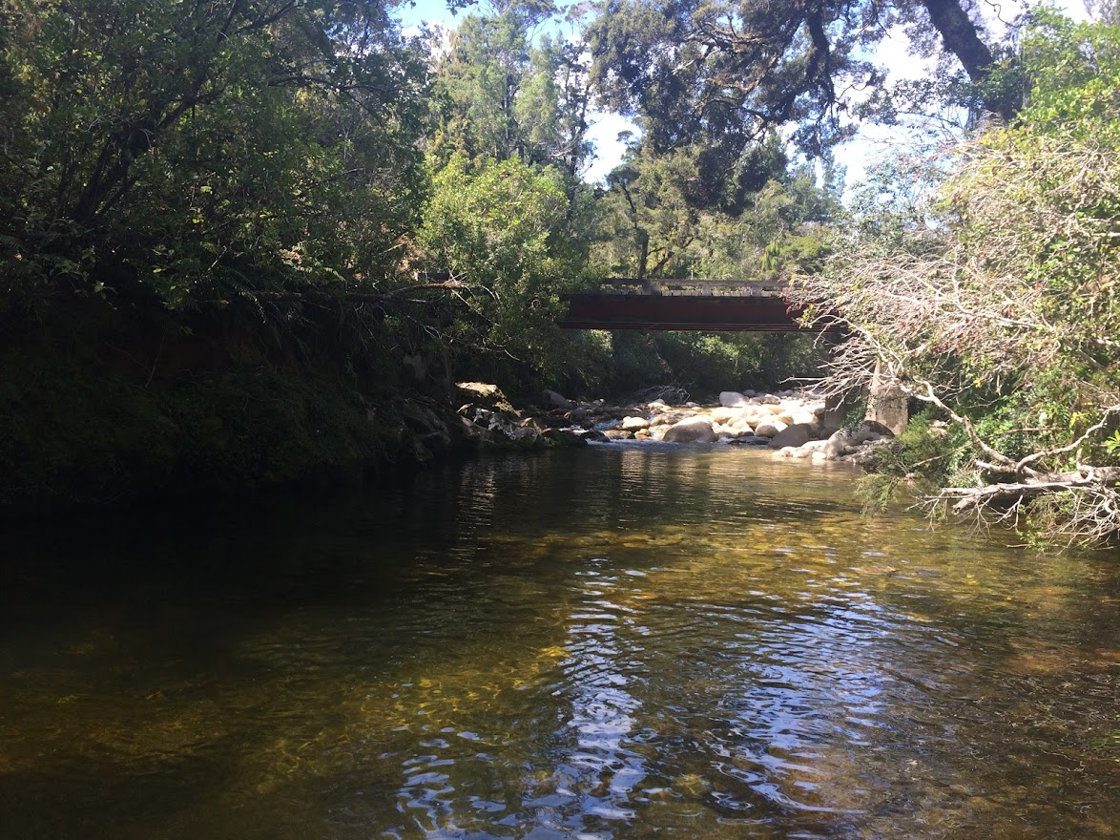
Study system: Reference streams…
Notes:
Toxic conditions; pH, Metals; loss of species
Assymertric reduction in biomass

Slide 44
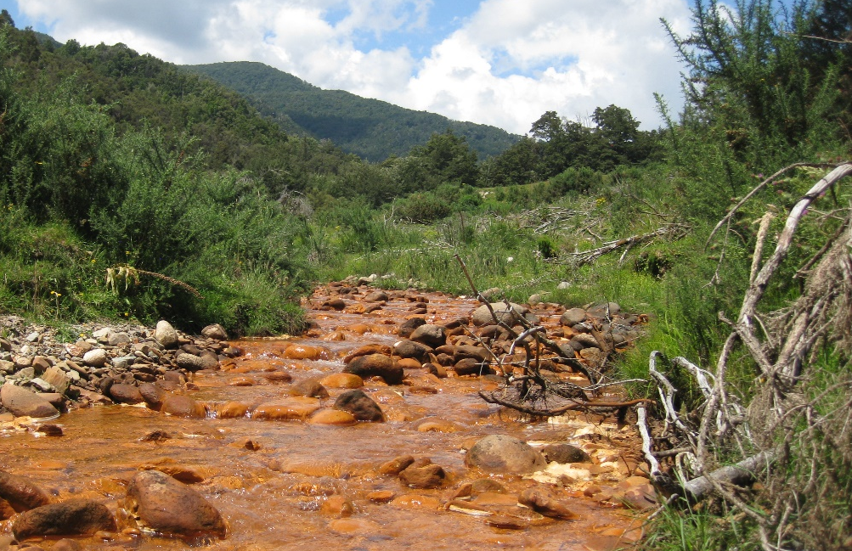
Study system: Reference vs. AMD streams…
Notes:
Toxic conditions; pH, Metals; loss of species
Assymertric reduction in biomass

Slide 45
Study system: Acid Mine Drainage (AMD)…
Legacy effects of coal mining
Sulfur-bearing ore exposed to water and oxygen
Sulfuric acid lowers pH
Increases solubility of associated heavy metals
Effects >12,000 miles of streams in US
Notes:
Toxic conditions; pH, Metals; loss of species
Assymertric reduction in biomass

Slide 46
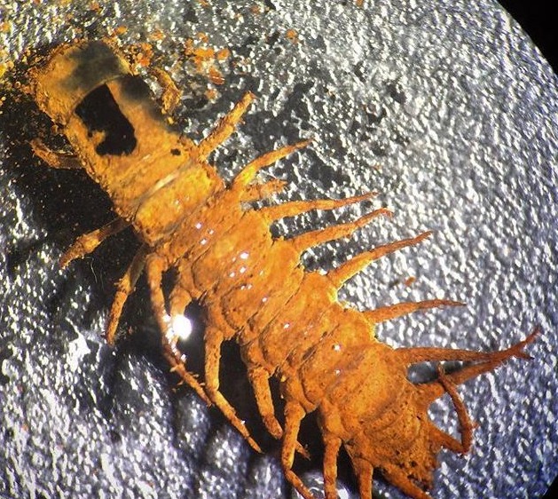
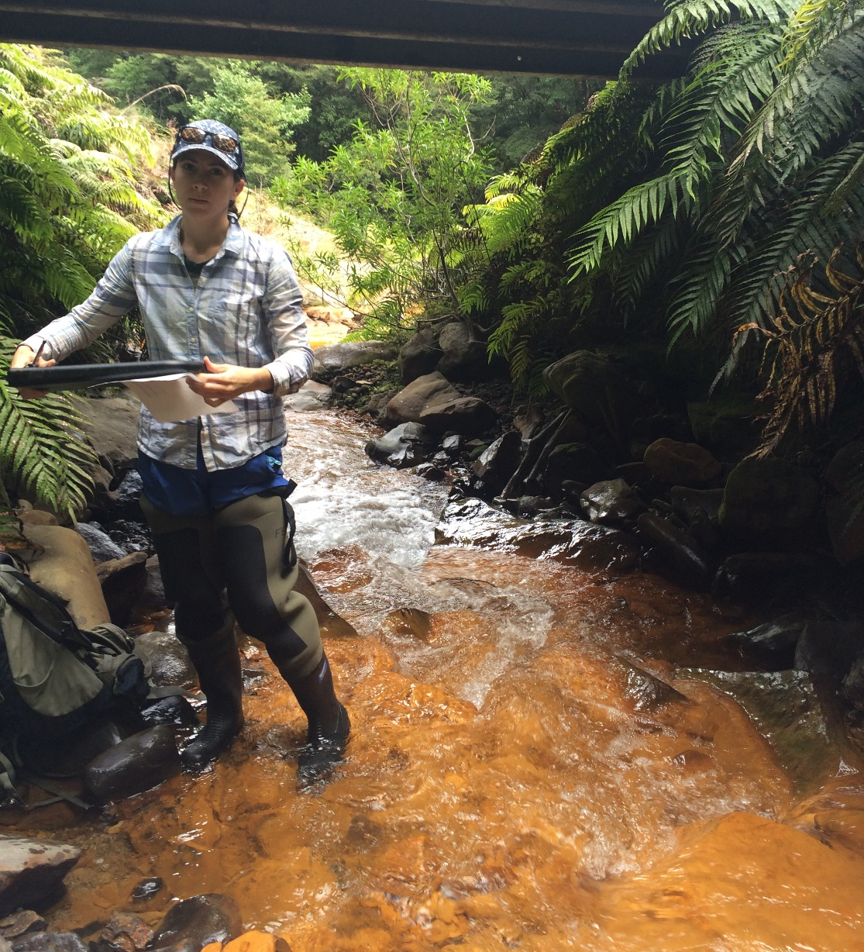
AMD creates extreme abiotic conditions…
Stream pH < 3 (lemon juice!)
Total dissolved metals > 30 mg/l
Increased energetic demands
Will size spectra respond?
Natural experiment to test ecological theory
Applications to management and restoration
Notes:
Toxic conditions; pH, Metals; loss of species
Assymertric reduction in biomass

Slide 47
AMD has significant impacts on community composition… Species loss and turnover Decreased total abundance
AMD

Slide 48

Effects of AMD on size spectra … ???
AMD
N
N
M
M

Slide 49
Lower abundance and diversity…
Larger individuals require more energy…

Slide 50
Prediction: Slope in AMD streams will be steeper…
Slope ~ -1.0
Decreased prey abundance and increased energy demands will support fewer large-bodied predators
Ref.
Slope < -1.0
AMD

Slide 51
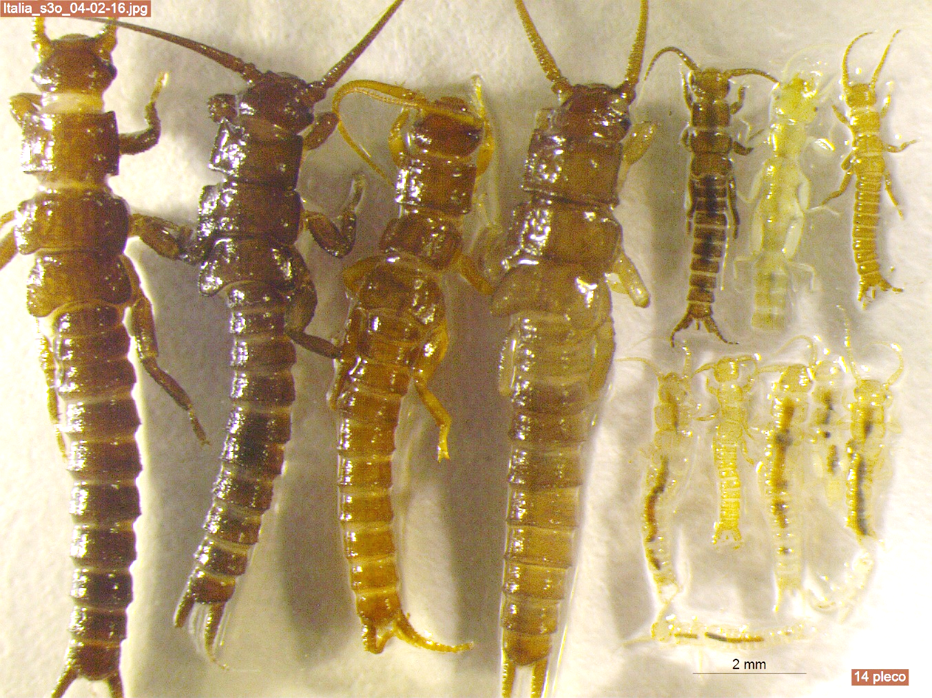
Non-destructive estimates of biomass…
Length-weight regression equations
Photos of all 12,416 individuals
Measured length (mm)
Estimated dry weight (mg)
Notes:
Measured all invertebrates, estimated biomass published length-weight regressions. Place in LOG2 bins and normalized abundance by dividing the count by the bin width

Slide 52
Group individuals into body size bins…
Log-transform body size (M) and abundance (N)
Biomass (M)
Log 10 Abundance (N)
Abundance (N)
Log 10 Biomass (M)

Slide 53
Individuals as “particles”…
Ignored Species Identity
Biomass (M)
Log 10 Abundance (N)
Abundance (N)
Log 10 Biomass (M)

Slide 54
Size spectra estimated with linear regression…
Slope ~-1
Biomass (M)
Log 10 Abundance (N)
Abundance (N)
Log 10 Biomass (M)

Slide 55
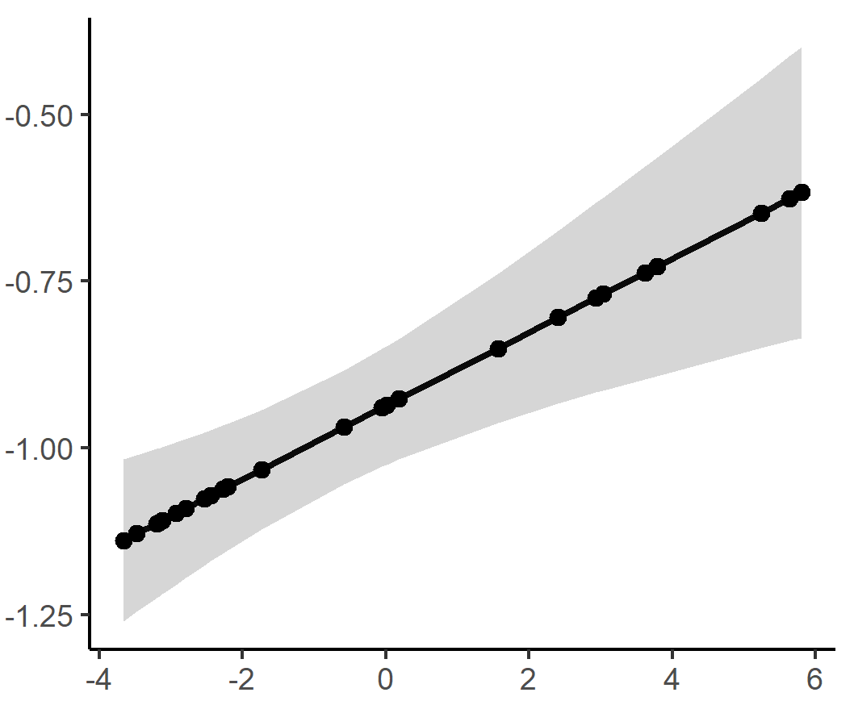
Do size spectra in unimpacted stream communities in NZ follow a consistent pattern?
Yes! Reference slopes between -1.15 and -1.00
Despite pH range of ~4-7
Estimated Slope
Mining gradient
Pomeranz et al. 2018

Slide 56
Do size spectra relationships change in response to AMD?
Yes! Slopes get consistently shallower with increasing AMD Supports use as “universal” indicator
Estimated Slope
Mining gradient
Pomeranz et al. 2018

Slide 57
Predicted steeper slopes, so what happened??
Slope ~ -1.0
Ref.
Estimated Slope
Slope < -1.0
AMD
Mining gradient
Pomeranz et al. 2018

Slide 58
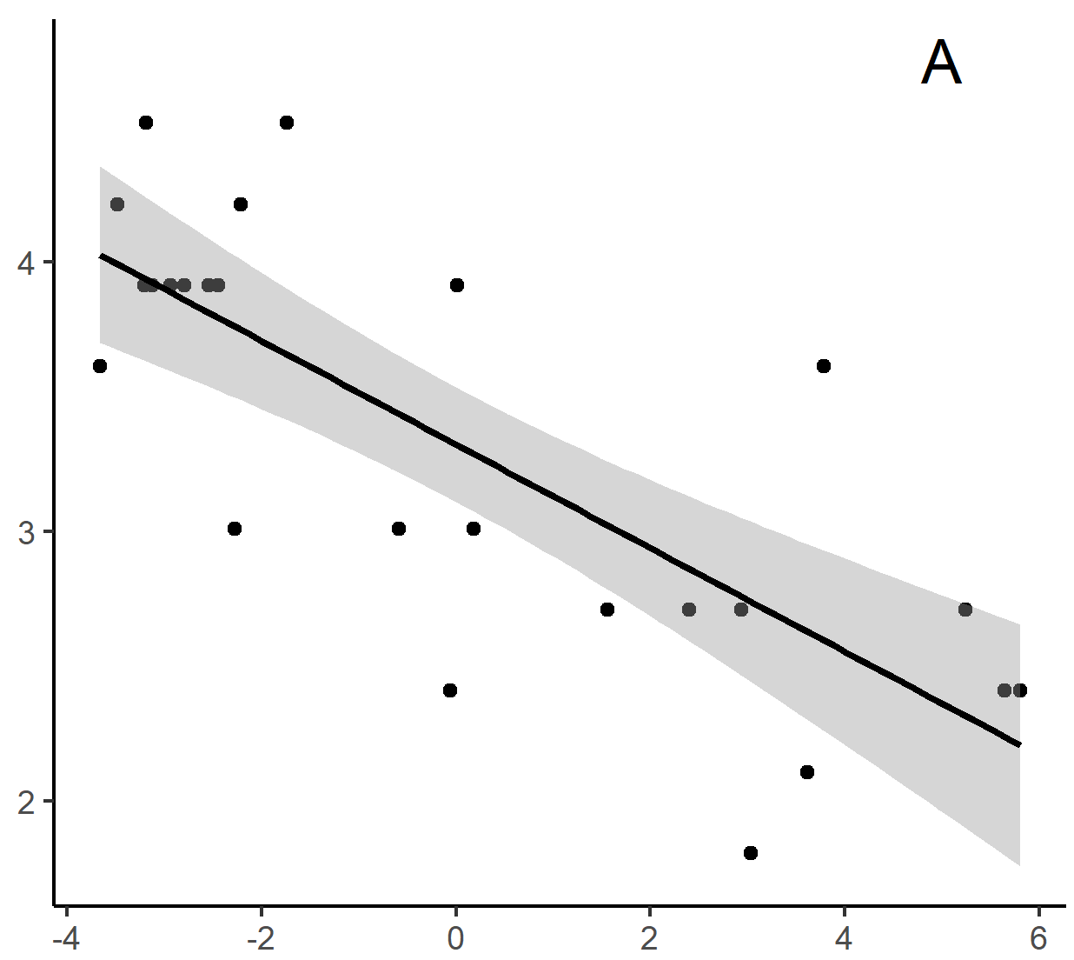
Large bodied predators completely removed… Fundamental changes to community organization in AMD-impacted streams
Log₁₀ range(M)
Mining gradient
Ref.
AMD
Pomeranz et al. 2018

Slide 59
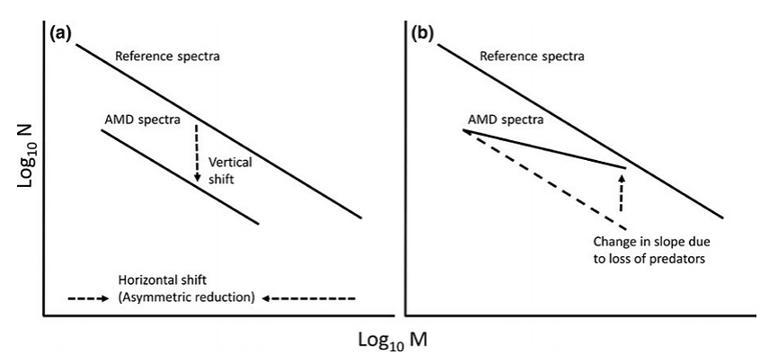
Size Spectra response and implications…
Reference
Pomeranz et al. 2018

Slide 60
Size Spectra response and implications…
Reference
Reference
Pomeranz et al. 2018
Impacted

Slide 61
Size Spectra response and implications…
Reference
Reference
Pomeranz et al. 2018
Impacted

Slide 62
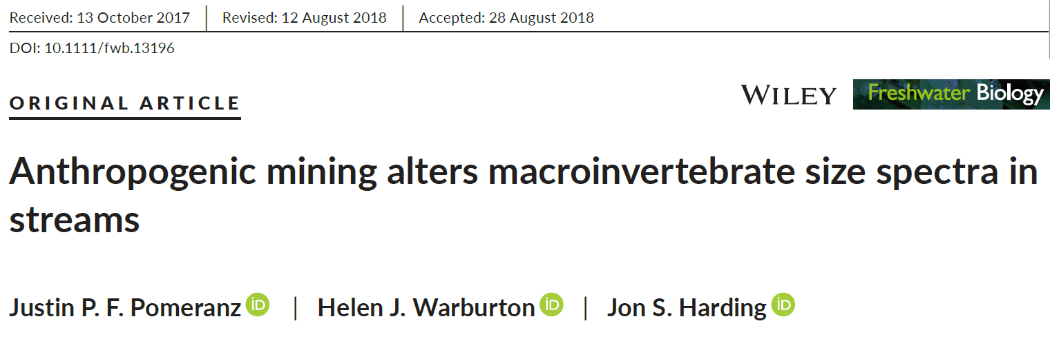
More details…
Pomeranz et al. 2018. Freshwater Biology

Slide 63
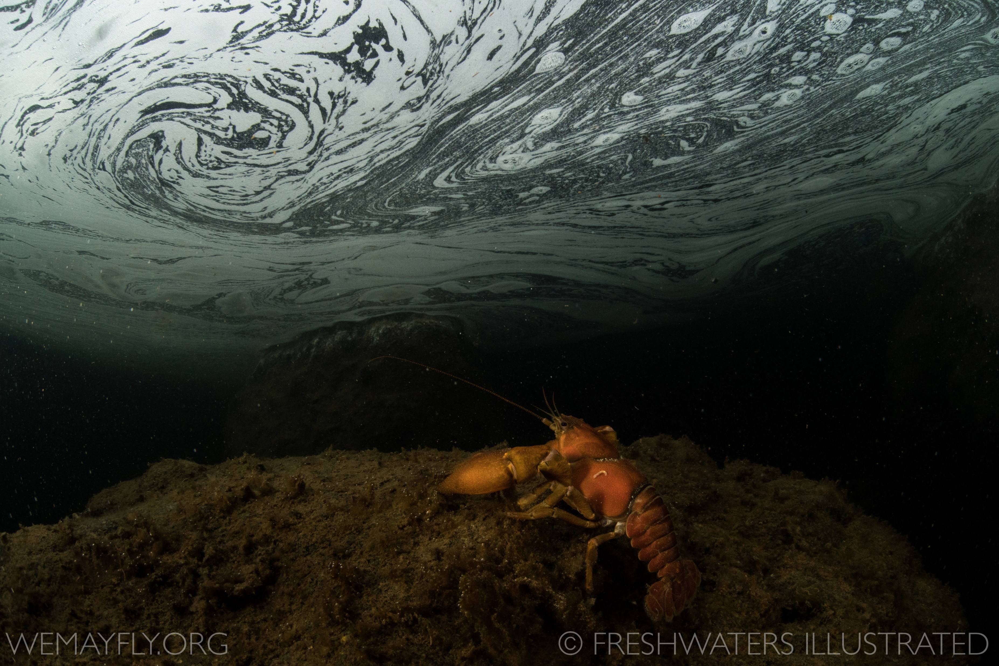
How will this research continue at CMU?

Slide 64
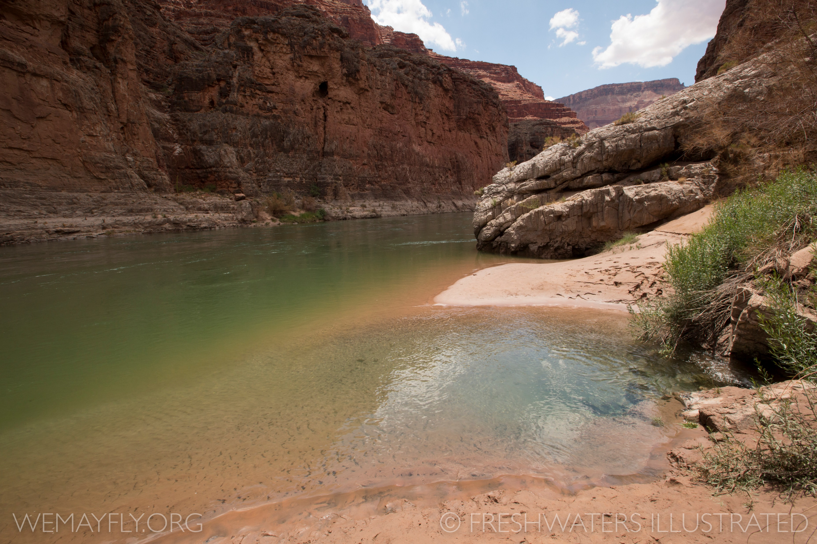
Future Research
What is the natural range of variation in size spectra?
What are the legacy impacts of hard rock mining in Colorado stream communities?
How do size spectra respond to restoration activities?

Slide 65
Environmental Temperature contributes to natural variation in body size distributions…
Temperature-size rule in individuals Atkinson 1994. Adv. Eco. Res.
Bergmann’s rule
Bergmann 1847. Gottinger Studien.
Size-spectra
Community-level
Individual-level
Cold
Abundance (N)
Body size
Hot
Temperature
Body size (M)
Notes:
Each A → one J, estimate strengths metabolic
Using strengths, calculate local STABILITY

Slide 66
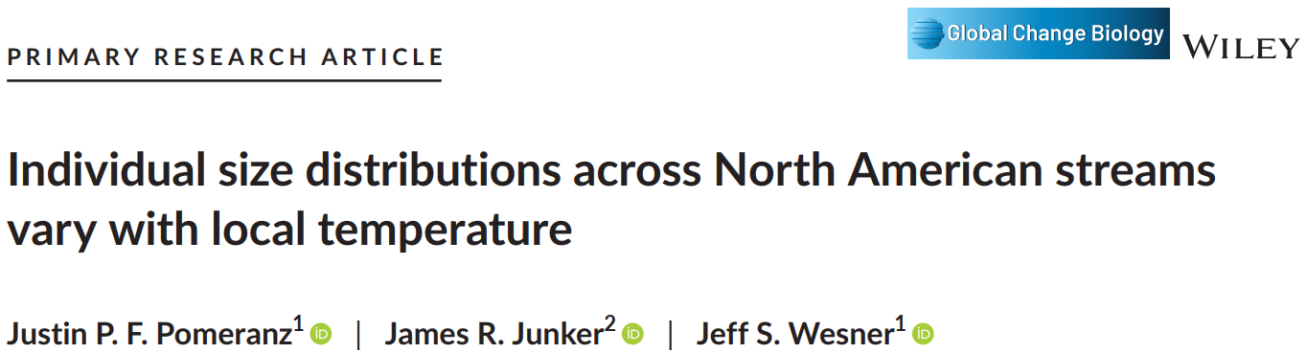
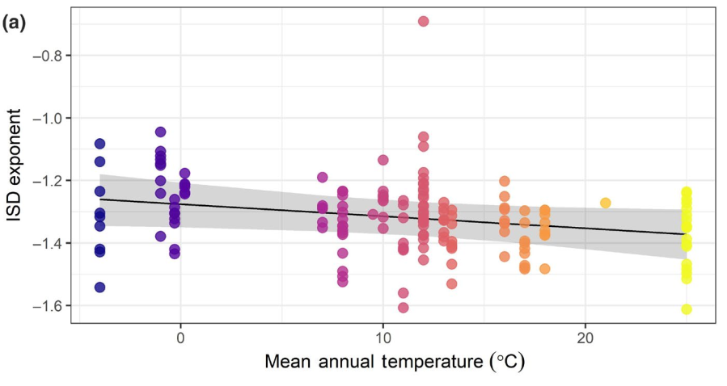
February 2022
Estimated Slope
Mean annual temperature (Cº)
Notes:
Each A → one J, estimate strengths metabolic
Using strengths, calculate local STABILITY

Slide 67
Resource availability may contribute to natural variation in biomass distributions…
Productivity tends to increase with temperature
Size-spectra
Resource-rich
Abundance (N)
Resource-poor
…counteractive effects?
Body size (M)
Notes:
Each A → one J, estimate strengths metabolic
Using strengths, calculate local STABILITY

Slide 68
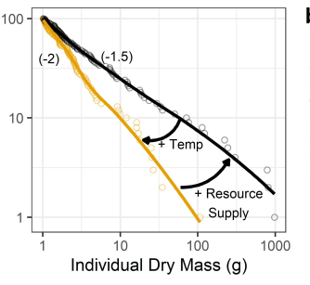
1. Temperature and resource supply may counteract one another in size-spectra relationships…
CMU ideally placed to investigate these interactive effects
Topographical and climatic variability
Mountains to deserts
Headwaters to the Colorado River
Undergraduate involvement at all stages of research process:
Experimental design
Field and lab work
Analysis and interpretation
Presentation
Notes:
Each A → one J, estimate strengths metabolic
Using strengths, calculate local STABILITY

Slide 69
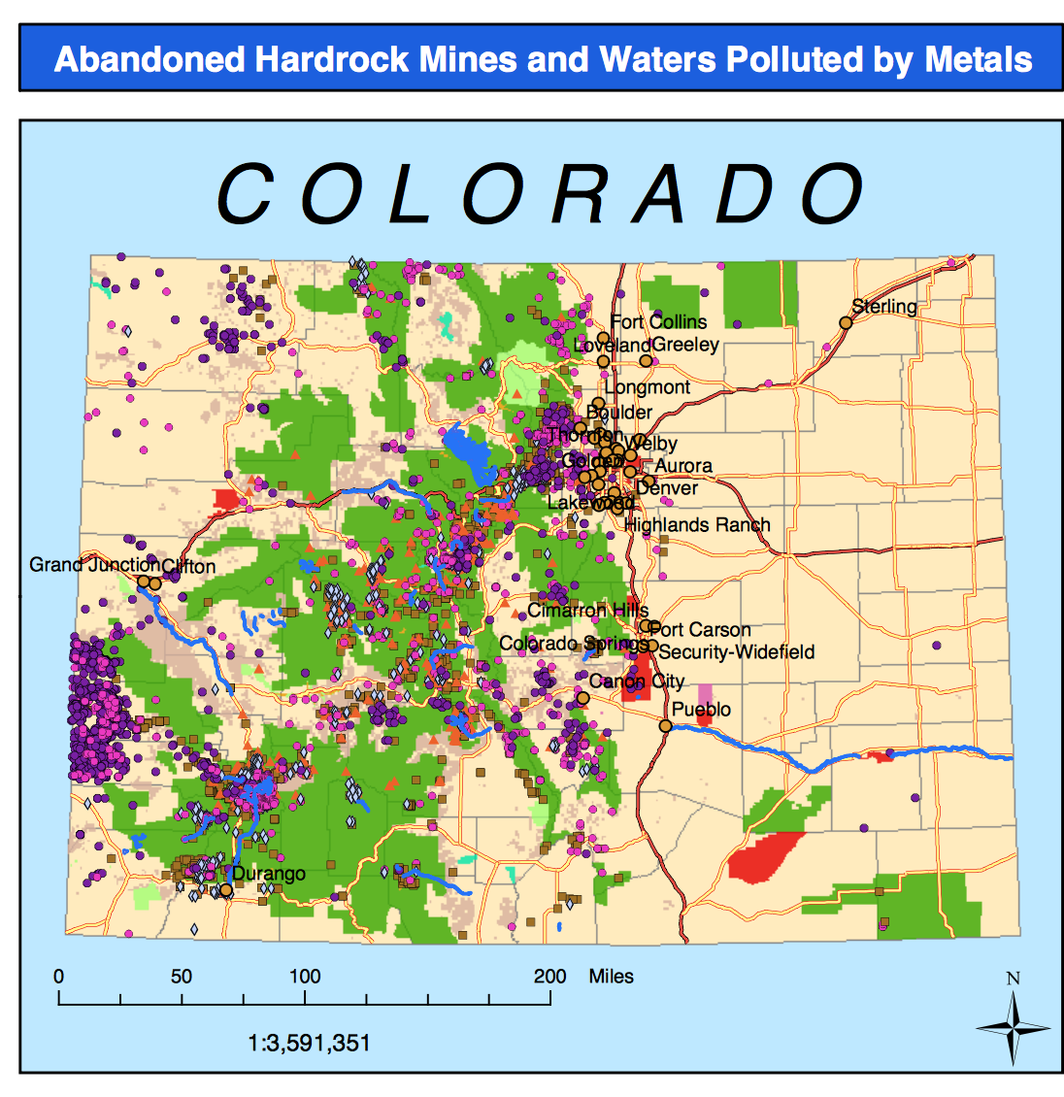
2. Legacy effects of mining in Colorado…
History of resource extraction in the CO Mineral Belt
>23,000 abandoned mines in CO
>1,800 stream miles impacted by mine-related pollutants
Traditional + size-based biomonitoring
www.colorado.gov/cdphe/wq-mining
Notes:
Each A → one J, estimate strengths metabolic
Using strengths, calculate local STABILITY

Slide 70
2. Legacy effects of mining in Colorado…
Patchy distribution of mineral deposits
Gradient of impact level
Paired streams to compare
Ideal study system for undergraduate projects
Undergraduate involvement at all stages of research process
Notes:
Each A → one J, estimate strengths metabolic
Using strengths, calculate local STABILITY

Slide 71
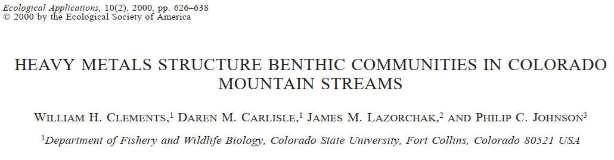
2. Legacy effects of mining in Colorado…
Notes:
Each A → one J, estimate strengths metabolic
Using strengths, calculate local STABILITY

Slide 72
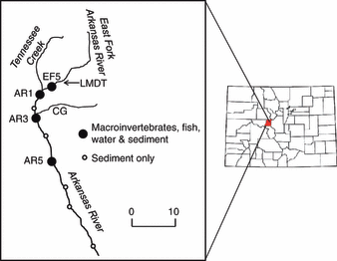
3. Size spectra trajectory in restored streams…
Arkansas River Superfund Site, CO
~30 years of data
Pre- and post- water quality restoration
Undergraduate opportunities for lab work, analysis, presentation
Work with Dr. Will Clements and other collaborators at CO State University
Ref.
Time
Ref.
Abundance (N)
Abundance (N)
WQ improve
Water treatment
Impacted
Body size (M)
Impacted
Body size (M)
Notes:
Each A → one J, estimate strengths metabolic
Using strengths, calculate local STABILITY

Slide 73
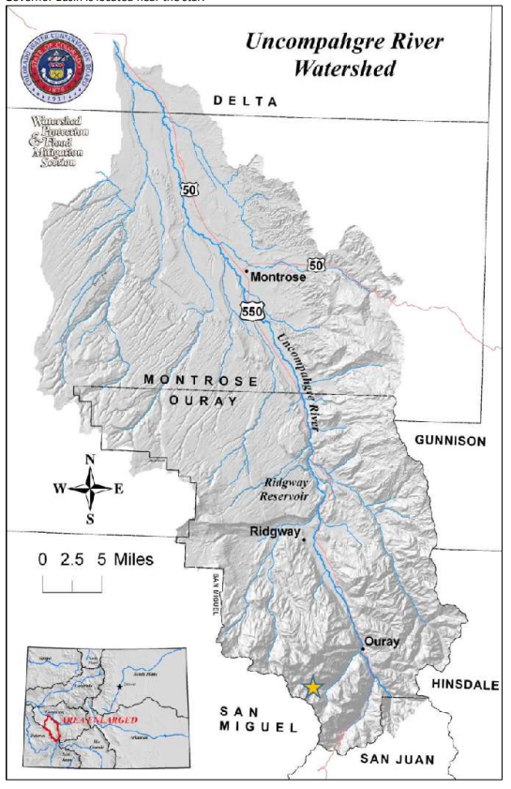
3. Size spectra trajectory in restored streams…
Governor Basin Restoration Project
Assess current condition of size spectra
Monitor change through time
Undergraduate opportunities for field and lab work, analysis, and presentation
Time
Ref.
Ref.
Abundance (N)
Abundance (N)
Water treatment
Impacted
Body size (M)
Impacted
Body size (M)
Notes:
Each A → one J, estimate strengths metabolic
Using strengths, calculate local STABILITY

Slide 74
Many impacts to freshwater in Colorado…
Water is a vital natural resource
Limited quantity and quality
Necessary to sustainably manage
Size spectra used to monitor human impacts to natural resource and characterize restoration
Applications to sustainable use and best management practices
Notes:
Each A → one J, estimate strengths metabolic
Using strengths, calculate local STABILITY

Slide 75
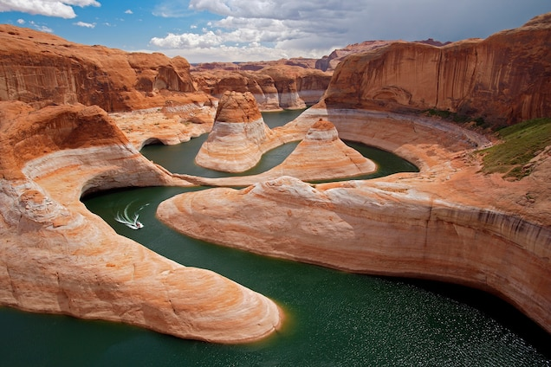
Climate change adds uncertainty to water quantity…
https://www.nationalgeographic.com

Slide 76
Take home…
Freshwater is an important natural resource in CO
Body size is a magic ruler: easy to measure, broad biologic implications
Size spectra are a “universal” pattern
Size spectra may simplify and broaden biomonitoring
CMU student opportunities
Notes:
Each A → one J, estimate strengths metabolic
Using strengths, calculate local STABILITY

Slide 77
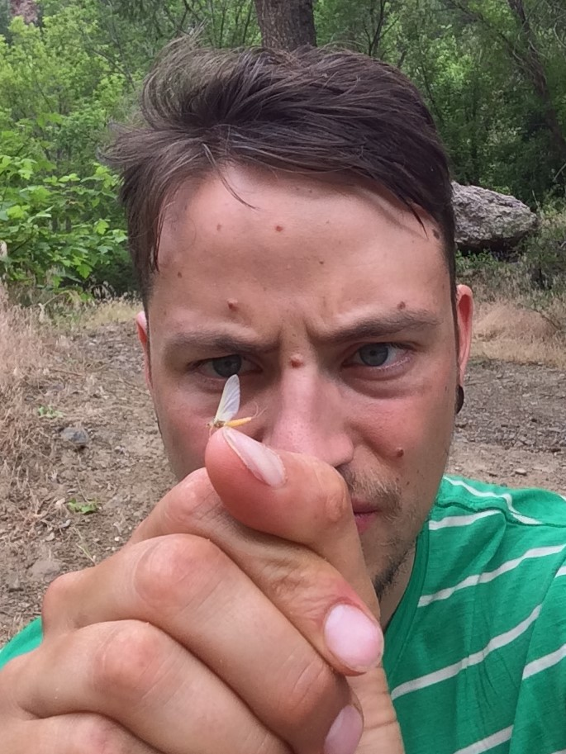



Thank You!
Questions?
Not enough thanks possible to Carlyn Perovich
… to my graduate advisers and committee members
… to all my collaborators and co-authors
… to Drs. Akira Terui and Jeff Wesner for my post-doc time at UNCG and USD, respectively
… thank you for listening!
jfpomeranz@gmail.com
@NotAPomegranite
github.com/Jpomz
jfpomeranz.wixsite.com/ecologist

